Slide 1





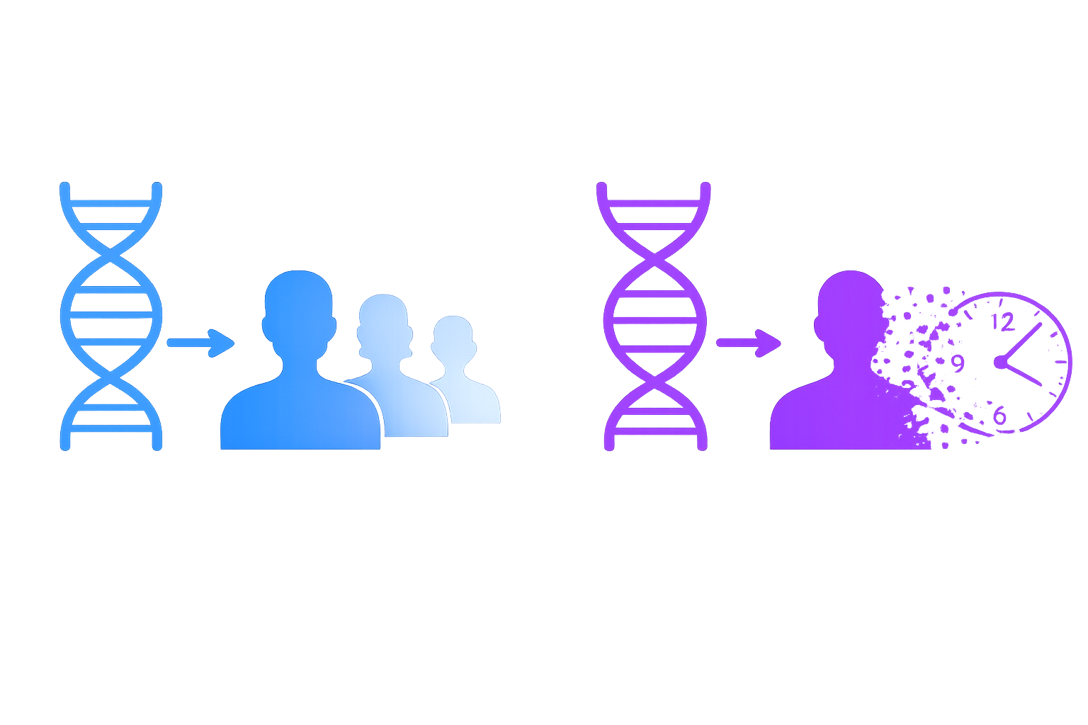
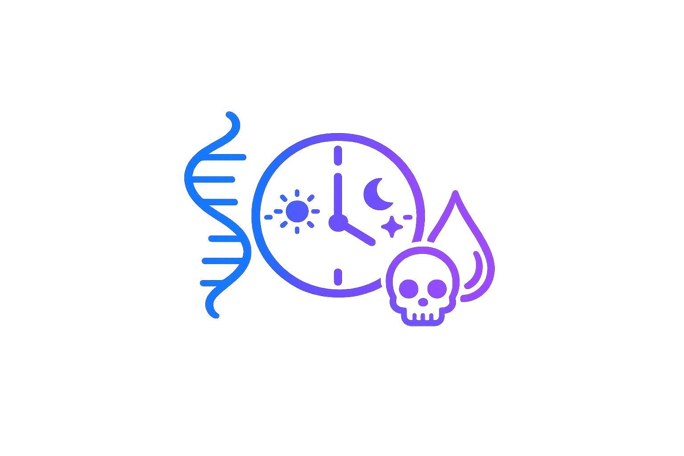
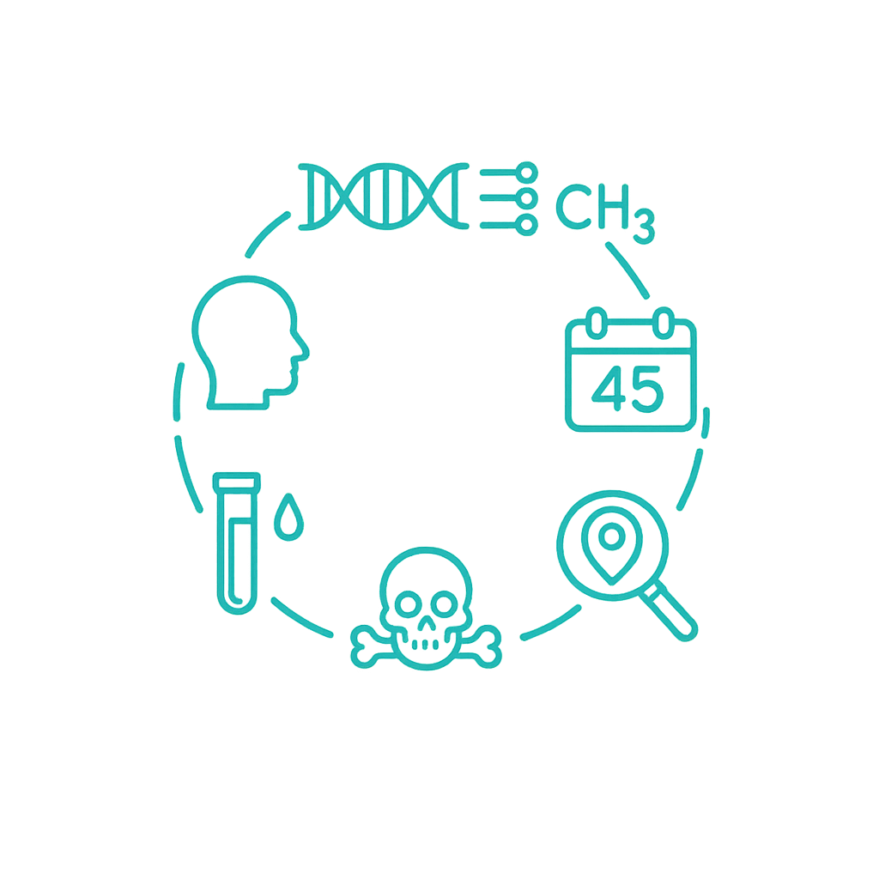

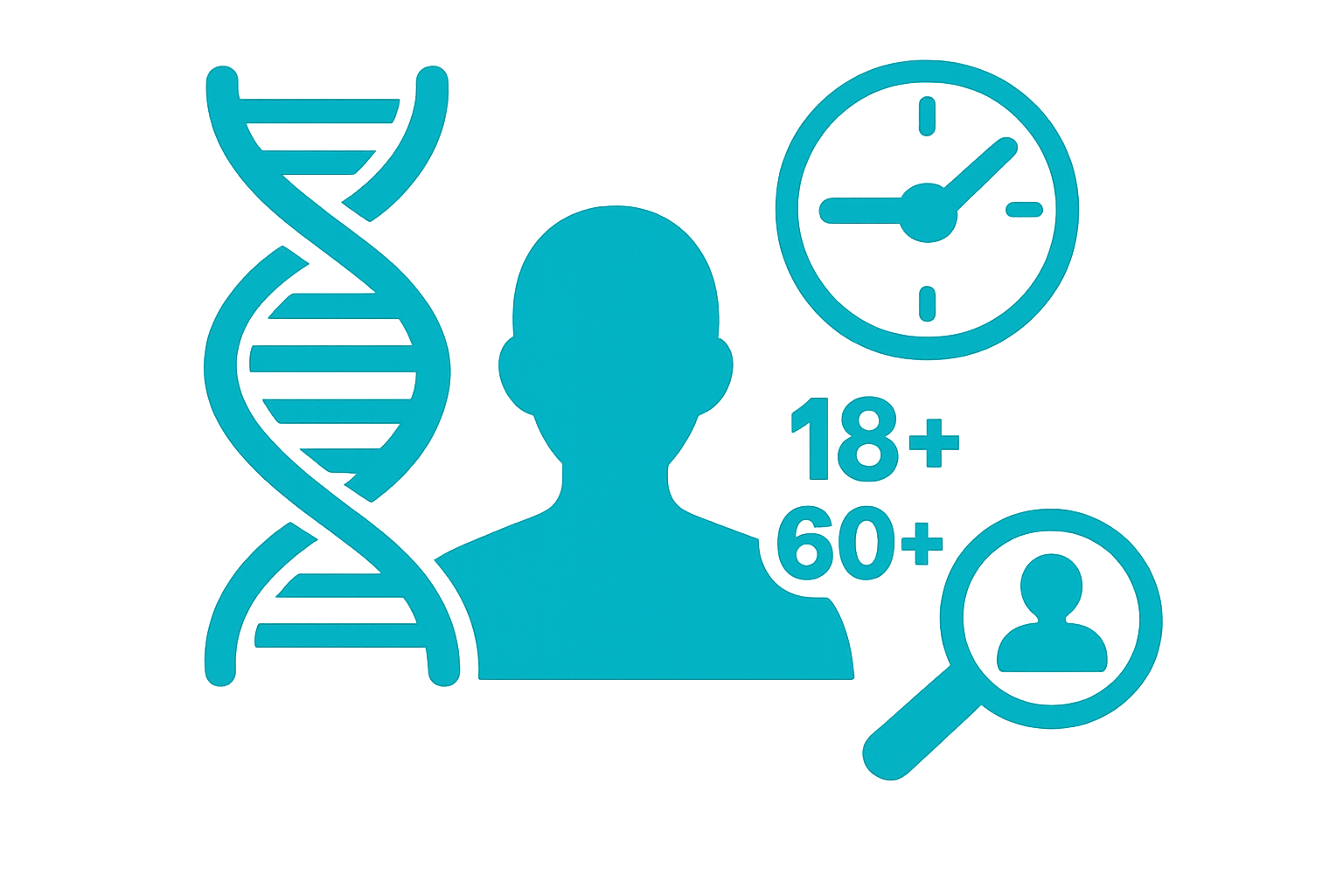
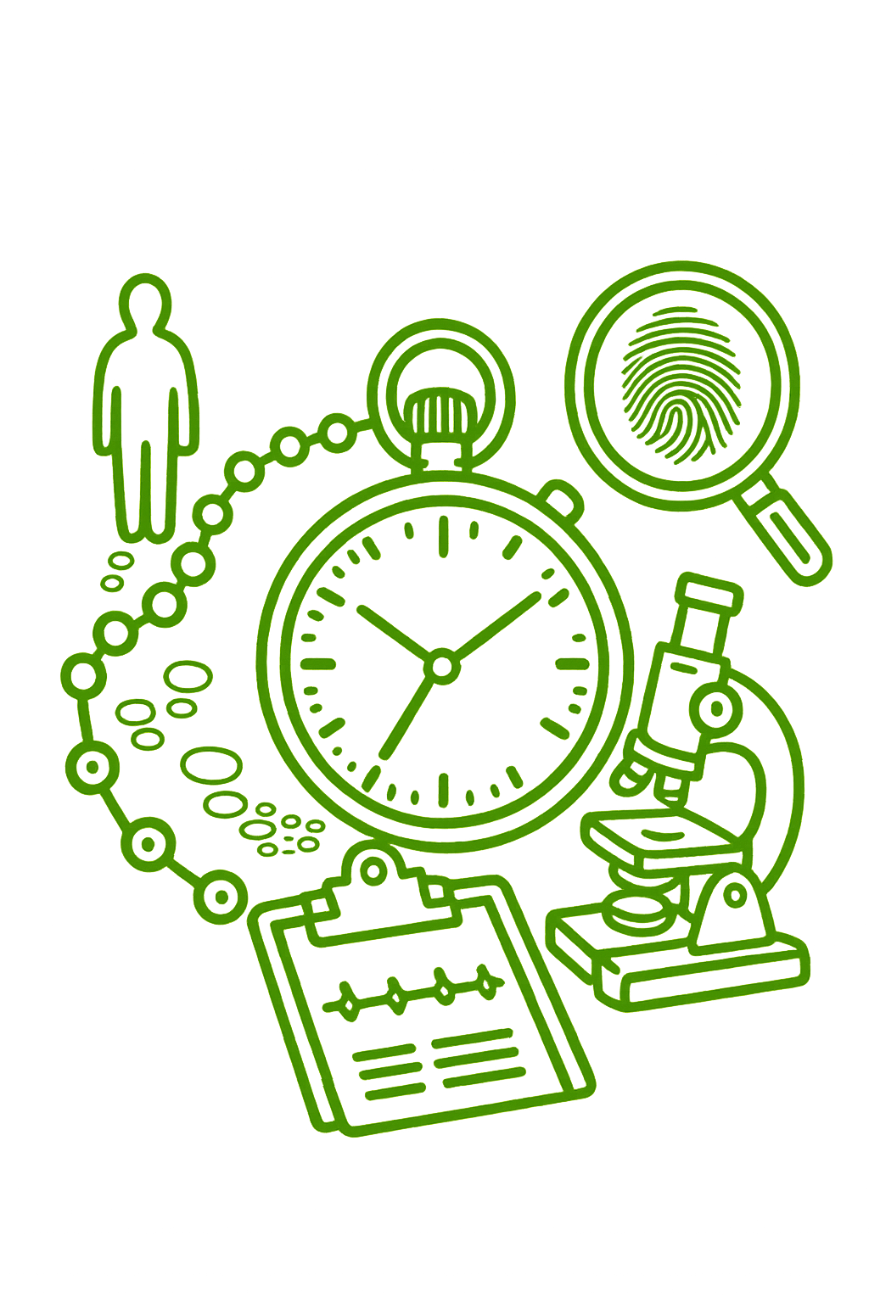


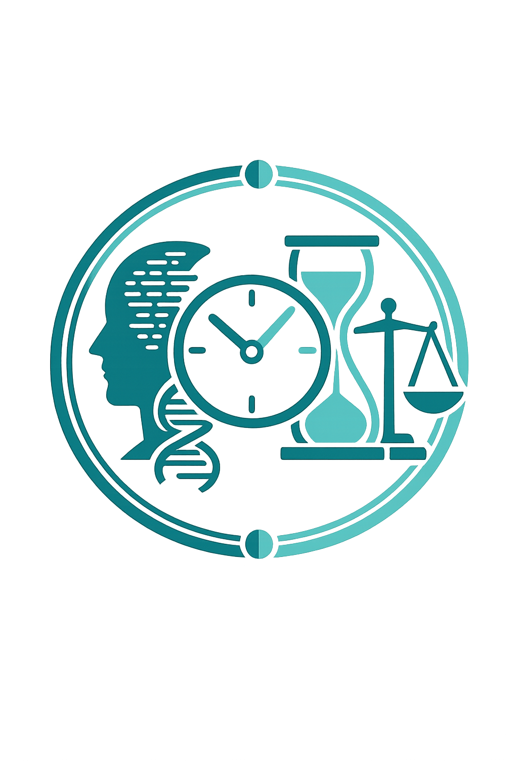
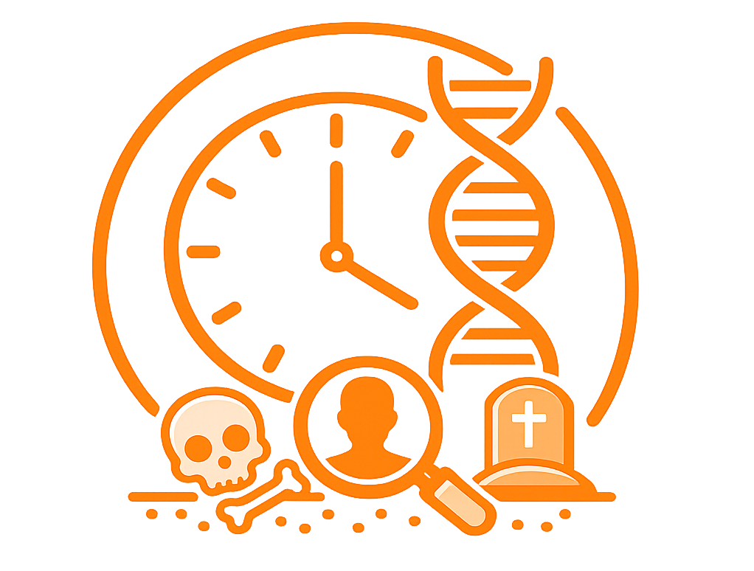
“OMICS-Clock”: Detect Age Estimation from biological fluids and bones through Epigenomics and Transcriptomics in Crime-scene investigation
Federica Sellitto¹, Sarah Gino², Noemi Procopio ³
¹ CRIMEDIM - Center for Research and Training in Disaster Medicine, Humanitarian Aid and Global Health, Università del Piemonte Orientale, Via Lanino, 1, 28100 Novara, Italy; Department of Health Science, University of Piemonte Orientale, via Solaroli 17, 28100 Novara, Italy
² Department of Health Science, University of Piemonte Orientale, via Solaroli 17, 28100 Novara, Italy; SSA Medicina Legale, AOU Alessandria, via Venezia 16, Alessandria, Italy
³ School of Law and Policing, Research Centre for Field Archaeology and Forensic Taphonomy, University of Central Lancashire, Preston PR1 2HE, United Kingdom
PROBLEM
INNOVATION
BEYOND THE "WHO": FOCUS ON TIME
THE OMICS-CLOCK FRAMEWORK FOR TIME-RESOLVED FORENSICS
In modern forensic genomics, STR-based DNA profiling is the gold standard for sub-source level, answering who a biological trace belongs to¹. However, this approach lacks a crucial dimension: time, fundamental to address activity-level questions.
Without temporal information, DNA evidence cannot reliably determine when a trace was deposited, limiting the ability to distinguish crime-related biological material from background or innocently transferred DNA (Figure 1).
«OMICS-clock» shifts forensic science from static DNA profiling to time-relevant investigation, addressing the temporal gap in forensics
RNA degradation -> RNA decay as molecular timer -> time since deposition (TsD) inference (when the trace was deposited)³
Circadian biology -> transcriptomics analyses of rhythmic genes
-> estimation of time of day (ToD) for body fluids deposition timing and cadaver death timing (day/night temporal resolution)^{4,5}.
Figure 1. Whilst standard DNA profiling can provide personal identification, temporal information can be achieved through transcriptomics and circadian biology.
Epigenomics -> DNA methylation -> donor age estimation² both for biological fluids on the crime scene (suspect) and for human remains in complex forensic contexts.
Beyond conventional DNA profiling, chronological age estimation of traces’ donors can provide also valuable investigative intelligence to support suspect identification when reference DNA profiles are unavailable (Figure 2).
This temporal vacuum is amplified in complex forensic contexts such as those involving human remains, particularly when subjected to advanced decomposition. These contexts would greatly benefit from improved temporal estimation methods.
Disaster Victim Identification (DVI) cases, skeletal remains, burials, mass graves, and environmentally exposed scenes are characterised by extensive biomolecular degradation, where estimating the time of death or the chronological age of the individual can provide critical intelligence to guide investigations² (Figure 3).
Machine-learning models will integrate multi-omics data to allow time estimation from trace evidence (TsD, ToD and chronological age) and skeletal remains (time of death and chronological age).
IMPACT
Figure 2. DNA-based chronological age estimation to support forensic investigations and suspect identification.
FROM MOLECULAR DATA TO JUSTICE AND CLOSURE
OMICS-Clock enhances evidence and alibi verification through objective trace timing and stronger forensic reliability^{3,5}.
OMICS-Clock transforms biological traces into objective molecular timelines, driving a paradigm shift in forensic science^{1,4}.
OMICS-Clock restores lost time by transforming biological evidence into answers for justice, unresolved cold cases, and families seeking the truth².
OMICS-Clock bridges the forensic gap between identity and time, shaping the socio-legal impact of temporal truth¹.
REFERENCES & ACKNOWLEDGEMENTS
Figure 3. Forensic estimation of chronological age and time of death in degraded remains.
Haas C, et al. FSI Genet. 2021;52:102486. doi:10.1016/j.fsigen.2021.102486
Procopio N, et al. Novel DNA Methylation Signature for Age Estimation from Forensic Bone Specimens. 2026 (Under revision).
Salzmann AP, et al. FSI Genet. 2021;53:102524. doi:10.1016/j.fsigen.2021.102524
Gosch A, et al. FSI Genet. 2025;78:103287. doi:10.1016/j.fsigen.2025.103287
Lech K, et al. FSI Genet. 2016;21:119-25. doi:10.1016/j.fsigen.2015.12.008
This unresolved gap highlights a critical limitation in forensic science: the lack of methods capable of integrating temporal information and donor-related biological features. Consequently, forensic investigations remain limited in their ability to reconstruct events, estimate post-mortem timelines, support victim identification, and strengthen the interpretation of biological evidence.
Illustrative AI-generated images were created using ChatGPT/DALL·E (OpenAI).
This manuscript is the result of a study conducted in the framework of the International PhD in Global Health, Humanitarian Aid and Disaster Medicine, organized by Università del Piemonte Orientale (UPO)
We acknowledge UKRI for funding the project with a Future Leaders Fellowship (N.P.) MR/Y019989/1.

